Slide 1
Special Cases: Licenses, Interpreted Languages, and Containers for DHTC Wednesday morning, 10:45 am
Christina Koch (ckoch5@wisc.edu)
Research Computing Facilitator
University of Wisconsin - Madison

Slide 2
Expanding Our Horizons
Previously, we were using simple, open source code that could be easily compiled or built.
This presentation discusses some special cases:
Licensed software
Running interpreted languages
Using containers

Slide 3
Licensing

Slide 4
Licensing
Many scientific softwares are licensed.
Licenses are restrictive, particularly for high-throughput computing

Slide 5
License Variations
Per machine or 'single-install’
Per running instance of the software (per “job”)
Per username / user
Via a license server
can support 1 - 1000s of concurrently running processes (“seats”)

Slide 6
Licensing implications for DHTC
Per machine or 'single-install': can’t be used for DHTC
Per job: restrictive, limits the number of jobs you can have running, how do you access licenses from execute servers?
Username: restrictive, could only run jobs on one system where your jobs run as *your username*

Slide 7
Approaches
Seek out open source alternatives
Python or R packages that emulate specific software behavior
If you can’t replace entire workflow, substitute free software where you can
License-free workarounds (Matlab)
Choose the least restrictive license possible

Slide 8
Interpreted languages

Slide 9


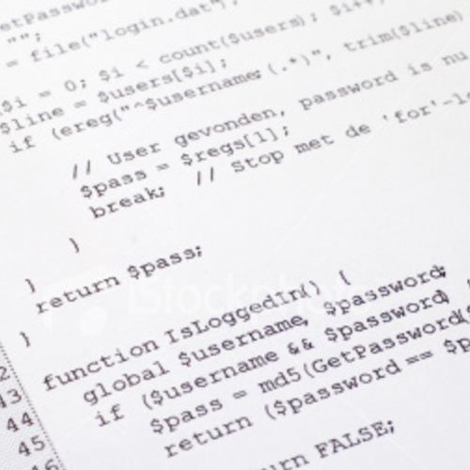


Interpreted code
Instead of being compiled and then run…
…interpreted languages are translated into binary code “on the fly”

Slide 10

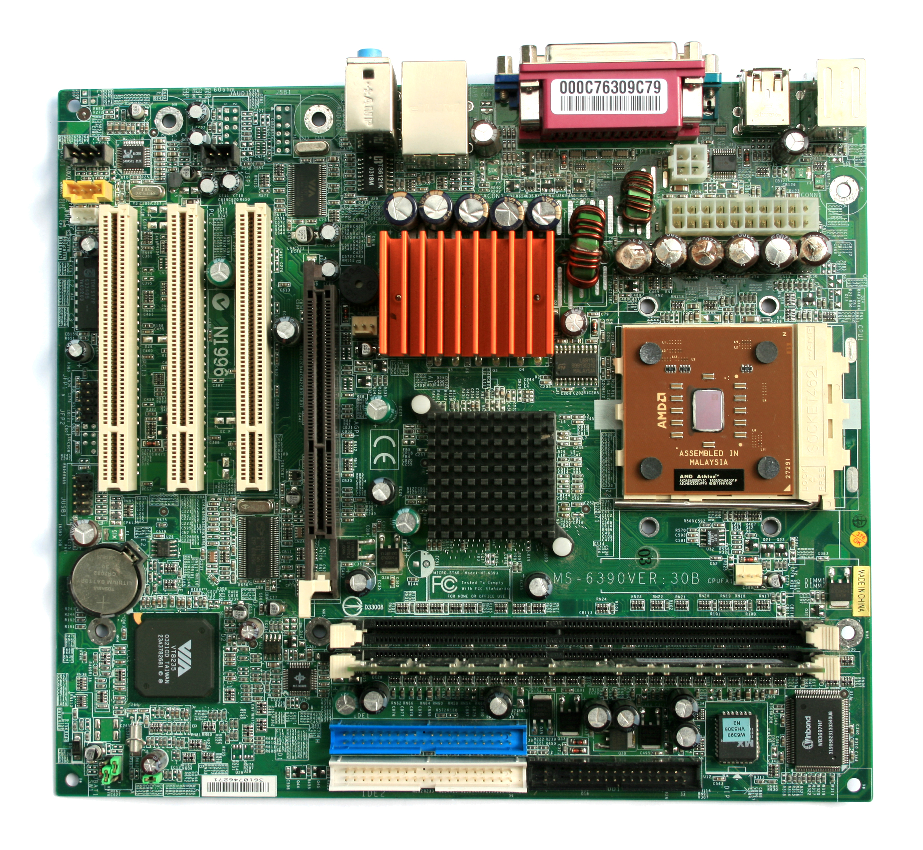
Interpretation
Script
Interpreter
text turns
into binary
instructions
uses
Libraries

Slide 11
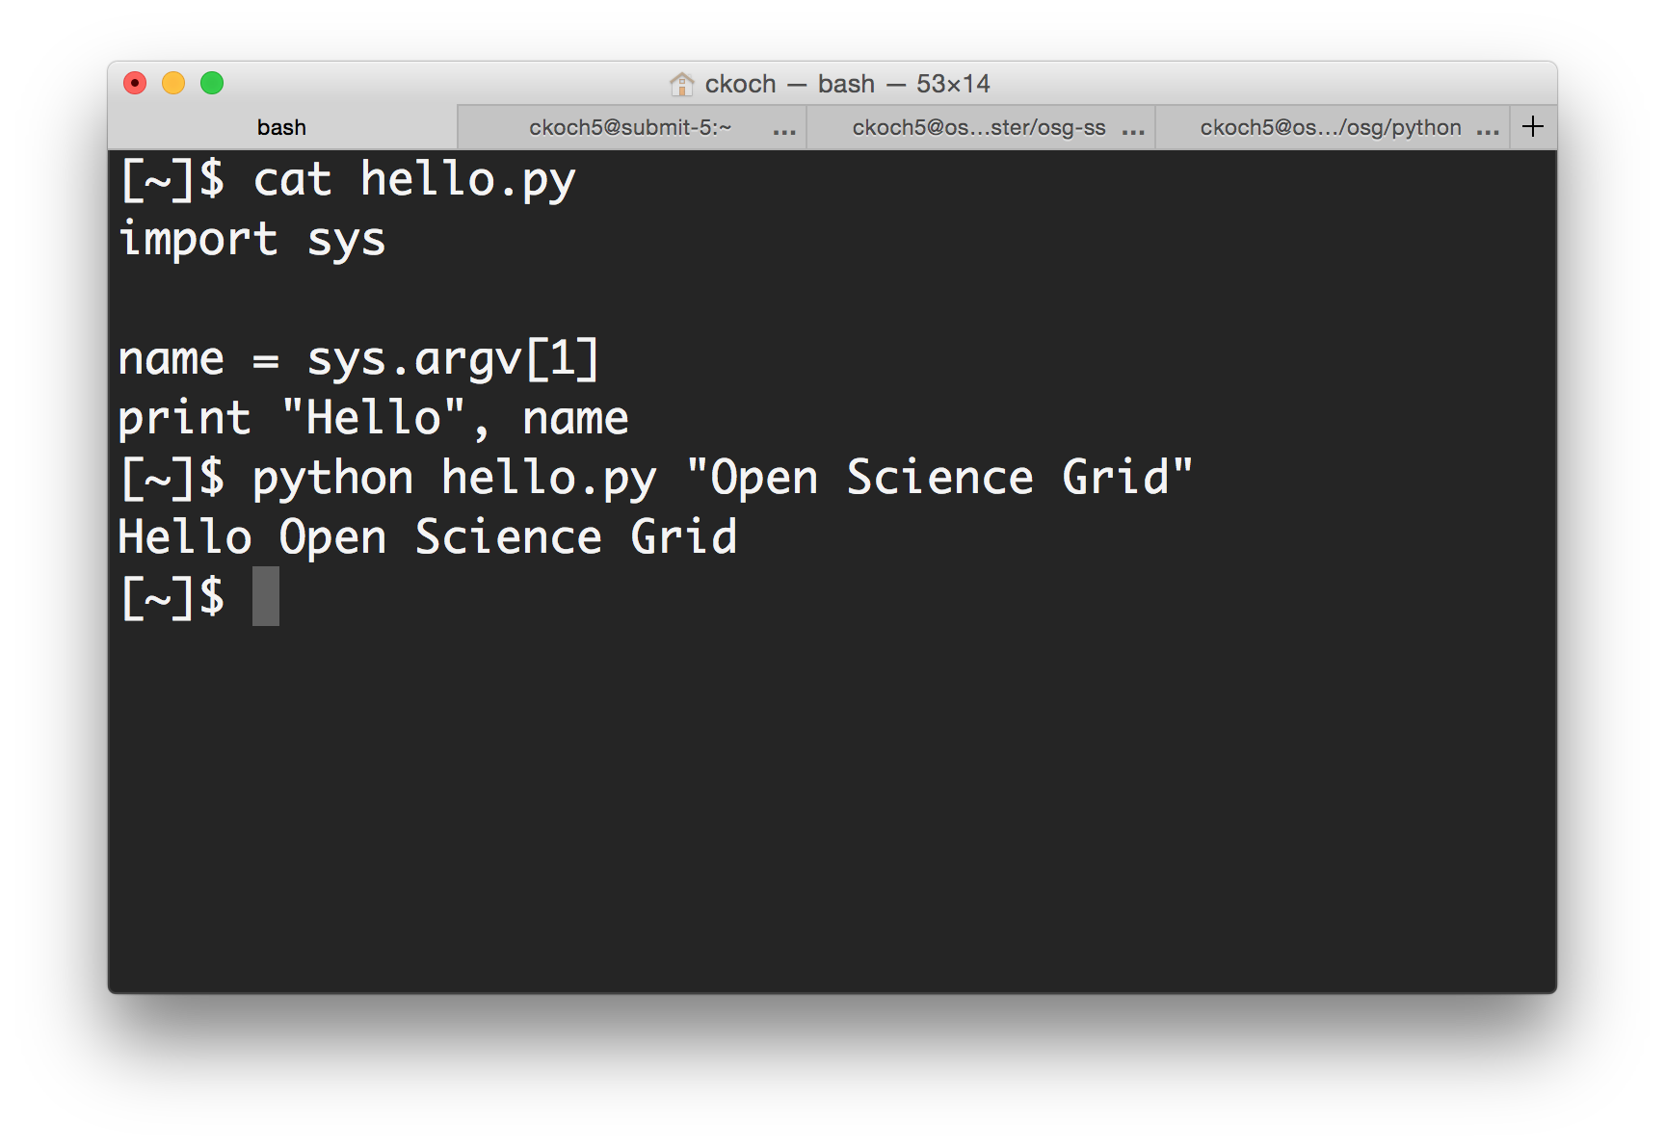
On the command line

Slide 12





Common interpreted languages*
Python
R
Julia
Ruby
Matlab
Perl
Javascript
*Note: the line between interpreted/compiled languages can be fuzzy. Many languages support both options, with one method being more common.

Slide 13
Running interpreted code in jobs
General procedure
Need to bring along interpreter and script
Use a wrapper script as the executable
Wrapper script will:
“Install” the interpreter
Run the script using the local installation

Slide 14
Python on DHTC
Create a portable Python installation (optional)
Bring along:
pre-built installation OR Python source code
your Python code
Use a wrapper script to:
unpack pre-built install OR install from source
run your Python script
(Similar to Exercise 1.4 this morning, will also work for R)

Slide 15
Matlab
Wait a minute…isn’t Matlab licensed?
Yes, when interpreted on your computer using a normal Matlab installation.
However, Matlab code can also be compiled.
Once compiled, the code can be run without a license using a (free) set of files called the Matlab runtime (which acts like the interpreter).

Slide 16
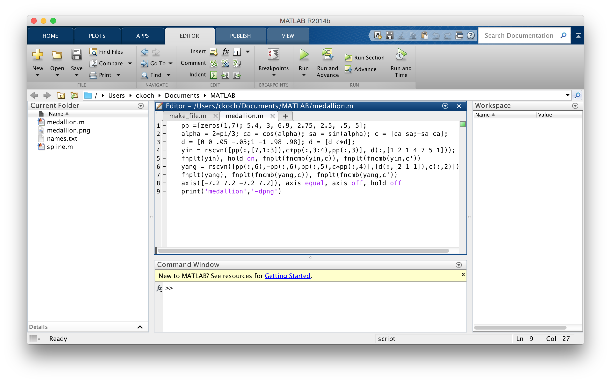


Matlab contrast
Running Matlab on your computer
Uses license per instance
Running Matlab on DHTC
Uses license once, runs many instances for free
Matlab script(s)
compiled w/ Matlab
compiler (uses license)
Compiled binary
interpreted by
Matlab Runtime (free)

Slide 17
Matlab on DHTC
Compile Matlab code using the Matlab compiler (mcc)
requires a license
Prepare a copy of the Matlab runtime
download for free from Mathworks
Write a script that “installs” the runtime
The Matlab compiler actually writes most of this script for you
Use the runtime install to run the compiled Matlab code

Slide 18
Containers

Slide 19

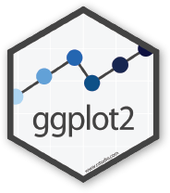


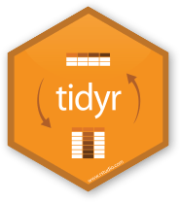
Containers
Containers are a tool for capturing an entire job “environment” (software, libraries, operating system) into an “image” that can be used again.
polaroid photos by Nick Bluth from the Noun Project

Slide 20


Using Containers in DHTC
Two common container systems:
Docker
https://www.docker.com/
Singularity
http://singularity.lbl.gov/
Requirements:
Underlying container system needs to be installed on the computers where your job runs
Permissions on that system allow the use of containers

Slide 21
Container Workflow
Create a container or find one online
DockerHub: https://hub.docker.com/
SingularityHub: https://singularity-hub.org/faq
Place container into public or private registry
Create a customized script/submit file that fetches/uses the container
Docker: Use HTCondor’s docker universe
Singularity: Wrapper script

Slide 22
Conclusion
To use any software in a DHTC system:
Create environment/software package
download pre-compiled code, compile your own, build your own, create/find a container
Write a script to set up the environment when the job runs
Account for all dependencies, files, and requirements in the submit file

Slide 23
Exercises
Running Matlab Jobs
Exercise 1.6
Running Python Jobs
Exercise 1.7: Pre-building Python and using that installation
Exercise 1.8: Writing a script that installs Python with every job
Half of the room should start with Matlab, the other with Python

Slide 24
Questions?
Now: Hands-on Exercises
11:15am-12:15pm
Next:
12:15-1:15pm: Lunch
1:15 onward: free time

